Slide 1





Enterprise Data Protection & Access Control - Transformers
Github Copilot GenAI Hackathon at Discover
OCTOBER 7 - 25, 2024
“Life's better with company. Everybody needs a co-pilot.”
~ George Clooney.

Slide 2





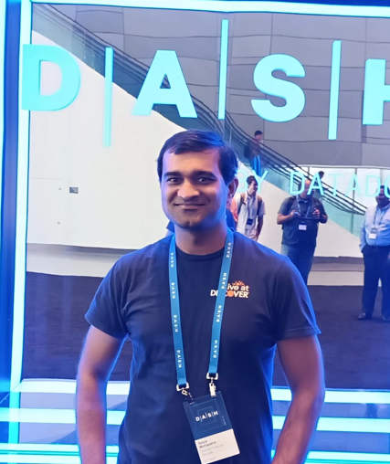

Transformers : Meet the Team
Sandeep Pattnaik
Venkata Sridhar
Gangavarapu
Nagesh Perumalla
Ninad Patkhedkar
Satya Prakash
Mohapatra

Slide 3
Problem Faced
Discover is a financial services company and deals with sensitive customer data. How can we ensure that access to AWS S3 data is controlled, secured, revoked after-use and audited to avoid any unintended consequences?
THE
CHALLENGE
Solution Offered
Security, Risk and Compliance: Discover uses AWS S3 and an in-house developed application, This solution will provide fine-grained access control to S3 data following industry-standard security principles and a rich customer experience.
Key Services: AWS S3, AWS API Gateway, AWS Lambda and AWS CloudWatch
The Benefits
Able to control individual user and application access to various S3 buckets and prefixes.
Simplify/offload work for App teams to get AWS creds to access S3 data.
Quick turnaround time to grant secured access to S3 data of customer’s interest.

Slide 4
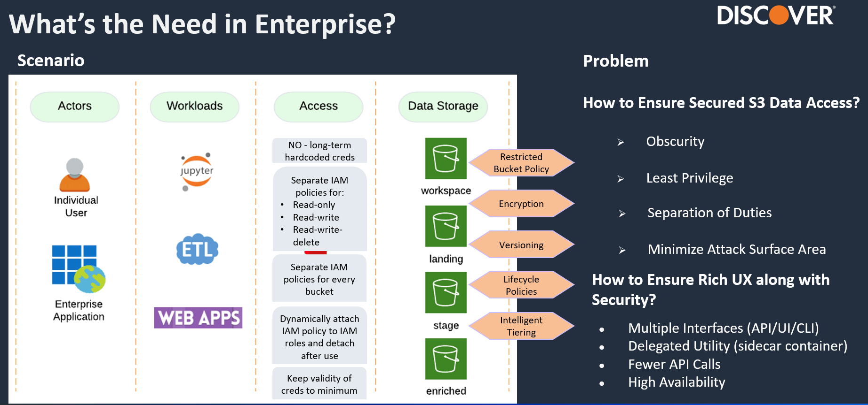


Slide 5
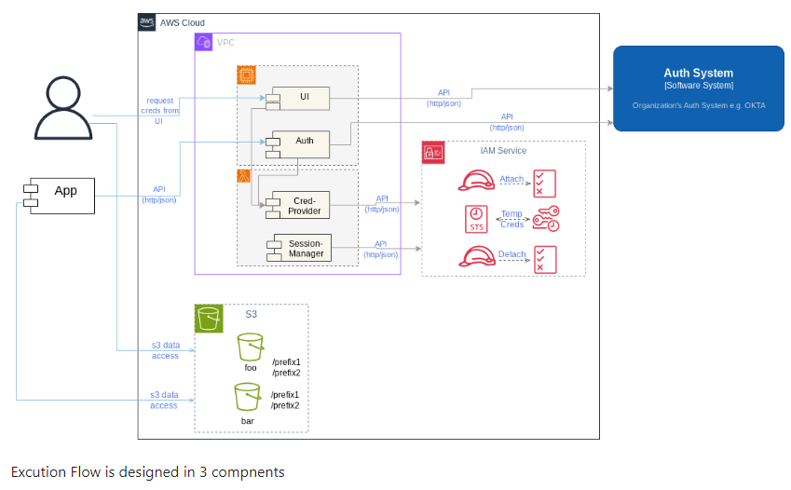
Architecture

Slide 6


Transformers Roadmap
Proof of
Concept
Transformers
MVP
Create application specific UI for consumers
Reduction of Additional Risk, Compliance related issues
Recommendations for Operational Excellence
This POC focuses on Enterprise Data Protection & Access Control*, using Github copilot to generate code for the fine-grained role-based access control.
Production Implementation. Using Github copilot generated code and customize as per customer needs and deploy using CI/CD pipeline
Creating user friendly Okta driven UI for our Customers where users can create the access by their own and do the needful.
Expand this use case to other AWS resources to have better control which will reduce risk and compliance related issues.
Provide recommendations to realize operational efficiencies and meet compliance requirements.
*Real environments could not be leveraged for the POC to prevent disruption to the business.

Slide 7
Productivity Improvement by using Github Copilot
Used Github Copilot to generate code as given in the glossary pages for 3 modules.
Generate Terraform code for S3 policy.
Generate Authentication and Authorization module.
Generate AWS lambda configuration code to deploy the module on AWS resource.
Overall, the Github copilot reduces 50% coding efforts. Whatever effort is needed is to customize the code as per the application need.
If we want to automate this through CI/CD pipeline, there also the script will be generated by Github copilot, and we just need to provide job specific details. When we want to expand to other AWS resources policies can be autogenerated. Also, when we want to create the UI, the react code can be easily autogenerated with Okta integration.
So, If we can compare overall, it reduces around 50-60% efforts in total development from scratch to full fledged automated solution.

Slide 8
THANK YOU
cdpl-leadgroup@discover.com

Slide 9
Appendix

Slide 10
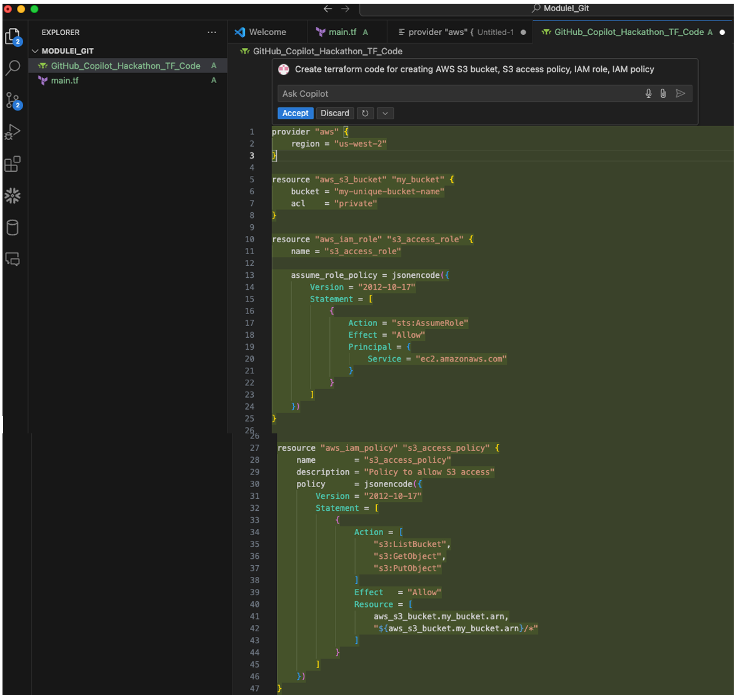
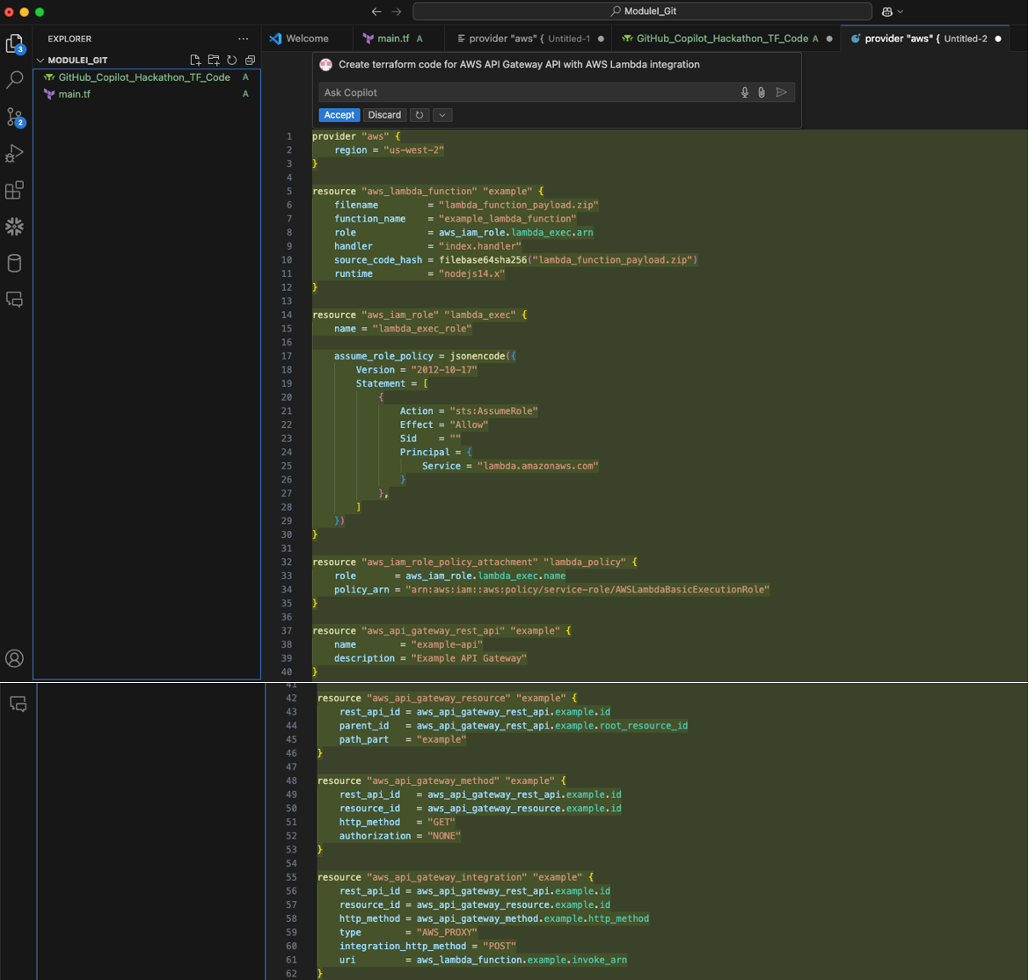
Copilot Screenshots for S3 Policy

Slide 11
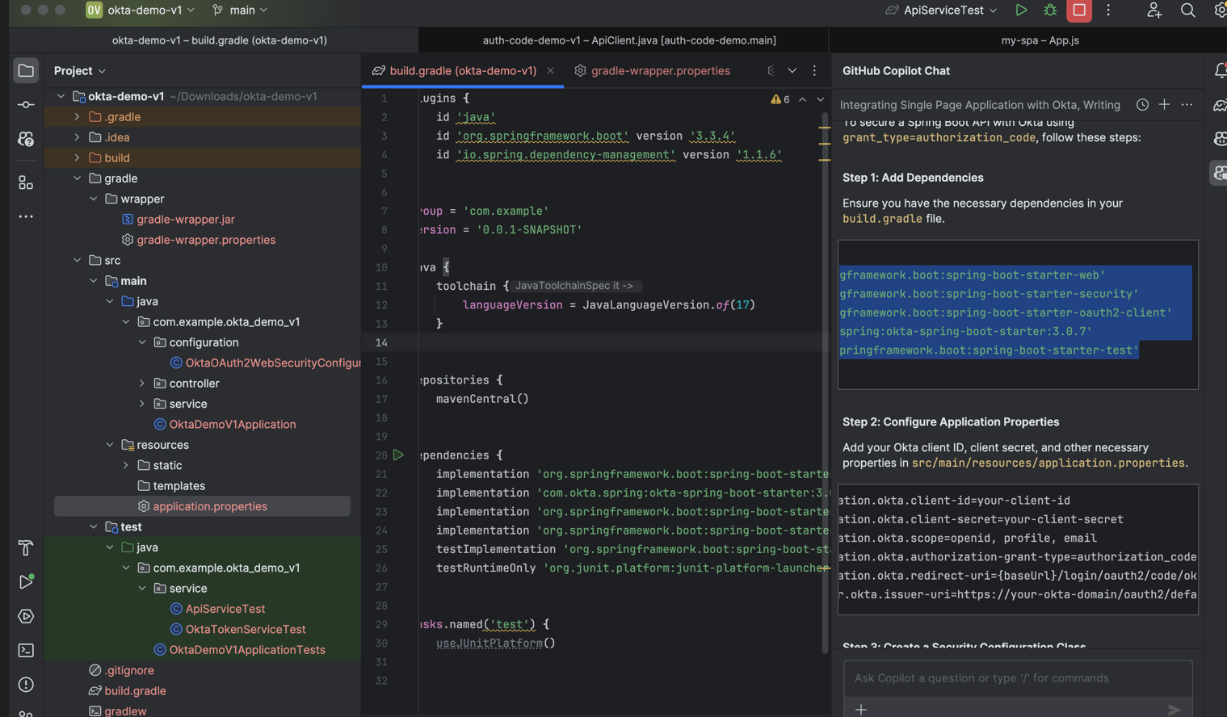
Copilot Screenshot for Authentication module

Slide 12
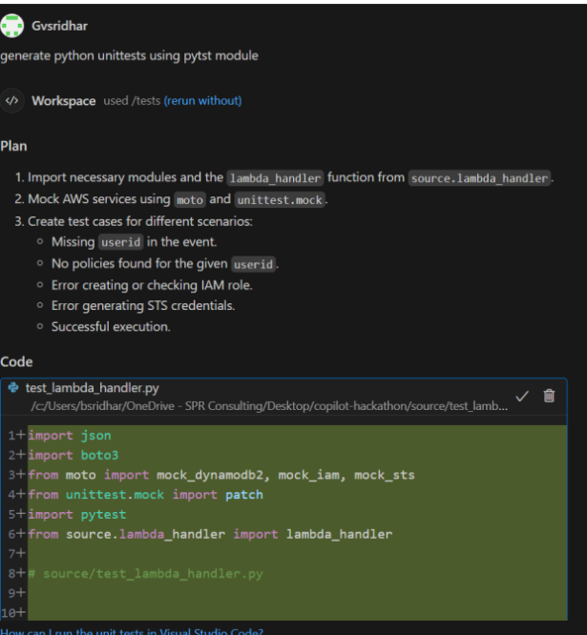
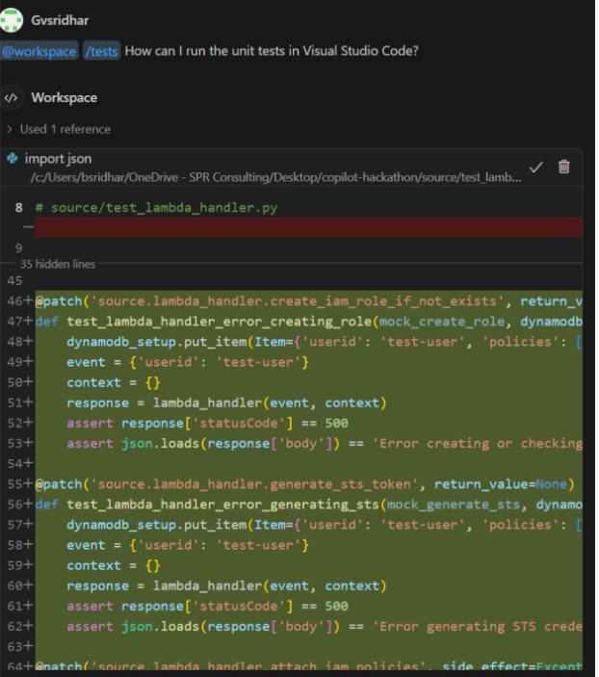
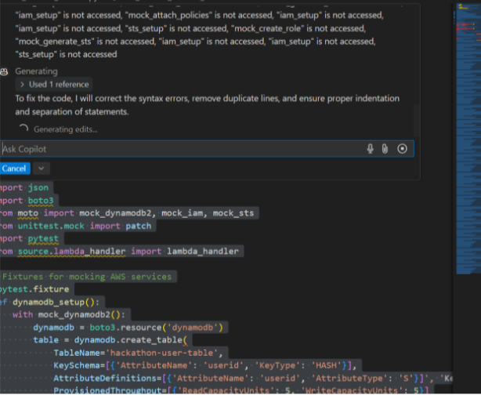
Copilot Screenshots for AWS lambda config

